Slide 1
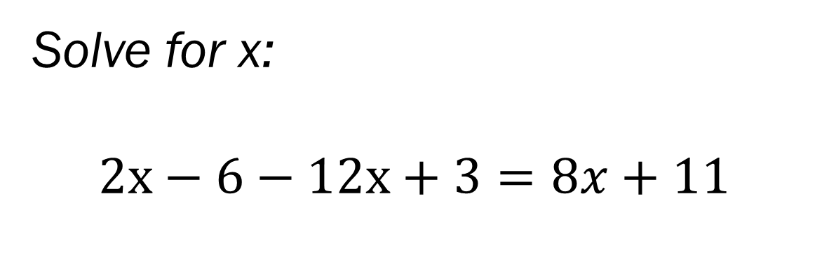
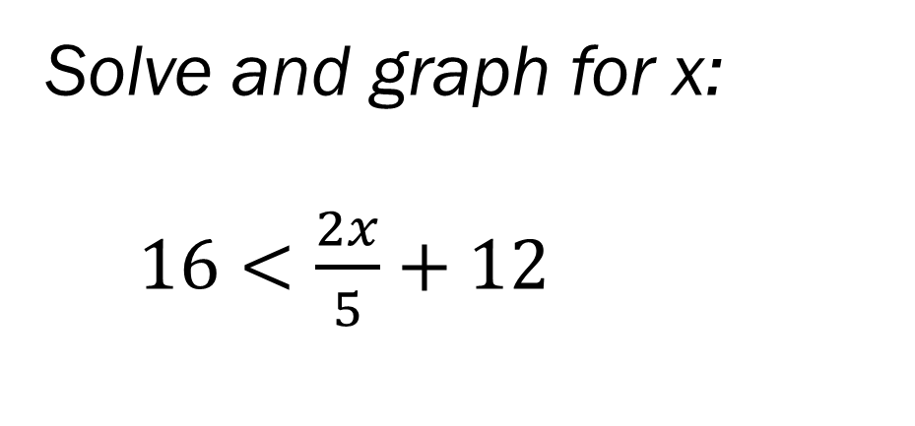
Bell Work
Solve and graph for x:
$16<\frac{2x}{5}+12$
Solve for x:
$2x−6−12x+3=8x+11$

Slide 2
From last time…
Pass Back Quiz
Go over any questions
Page 37 homework questions

Slide 3
From Last Time…
From Last Time
Page 37-38 #3-5, 10, 27, 31, 35, 44
Mixed Review
Page 40 #72, 75, 78

Slide 4
ALGEBRA 3
Day 10

Slide 5
Chapter 1 Section 6 Absolute Value Equations and Inequalities
Objective: To write and solve equations and inequalities involving absolute value

Slide 6
Quick Review Absolute Value
Absolute Value → A numbers distance from zero (distance is always positive) identified with the | | symbol
For Example:
|7| = |-7| = 7 because both are 7 away from zero
Simplify: |-2.4| and |19|
How does this change if we put a variable inside the brackets?

Slide 7

1.6 Absolute Value Equations and Inequalities
Solve for x: Solve for x:
|x| = 2
Solve for x: Solve for x:
6|$\frac{1}{2}x−1$|+ 3 = 33 |2x + 19 | + 12 = 8

Slide 8

1.6 Absolute Value Equations and Inequalities
Solve for x: Solve for x:
|x| < 2 2|$x+3$|- 1 > 7
Solve for x: Solve for x:
6|$\frac{1}{2}x−1$|+ 3 > 33 |2x + 1 | - 12 ≤ 8

Slide 9
Quick Check for Understanding
If a variable is inside of |absolute value| how many answers will you have and why?

Slide 10
For Next Time…
For Today
Page 45 #2-5, 29, 45, 65
Mixed Review
Page 48 #96, 99

